Slide 1
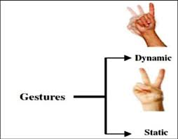
What is SLR?
SLR aims to translate sign language into text. It can be static (word-based) or continuous (sentence-based).

Slide 2
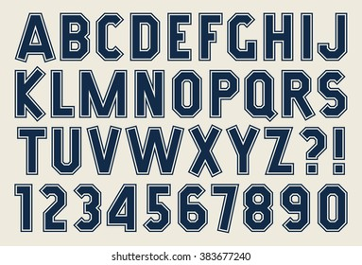
Static SLR Using a Simple DLL
Initially, we used a simple deep learning model with a DLL (Dynamic Link Library) for static SLR.
Link: https://www.kaggle.com/code/robottticsss/nnmnist/edit/run/221267165
Initially we implem-
-nted for 24
alphabets(w/o
j and z)

Slide 3
Why Shift to CNN for Continuous SLR?
Static models fail in continuous SLR. CNNs help extract features from video frames.
The 2D CNN’s ensured accuracies of 20-30%.
While the 3D CNN’s ensured accuracies of 30-45%......

Slide 4
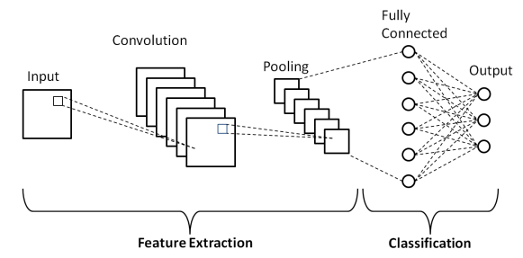
What is a CNN?
CNNs extract spatial features from images using convolutional layers.

Slide 5
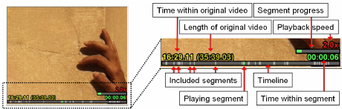
Limitations of CNN for Continuous SLR
CNNs don't capture sequence dependencies well. Needed a better approach.

Slide 6
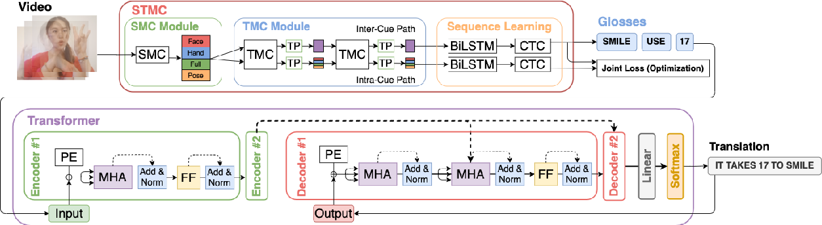
Adopting State-of-the-Art Approach
We moved to a two-stage approach:
SMTC: Converts video to glosses.
Transformers: Converts glosses to natural text.

Slide 7
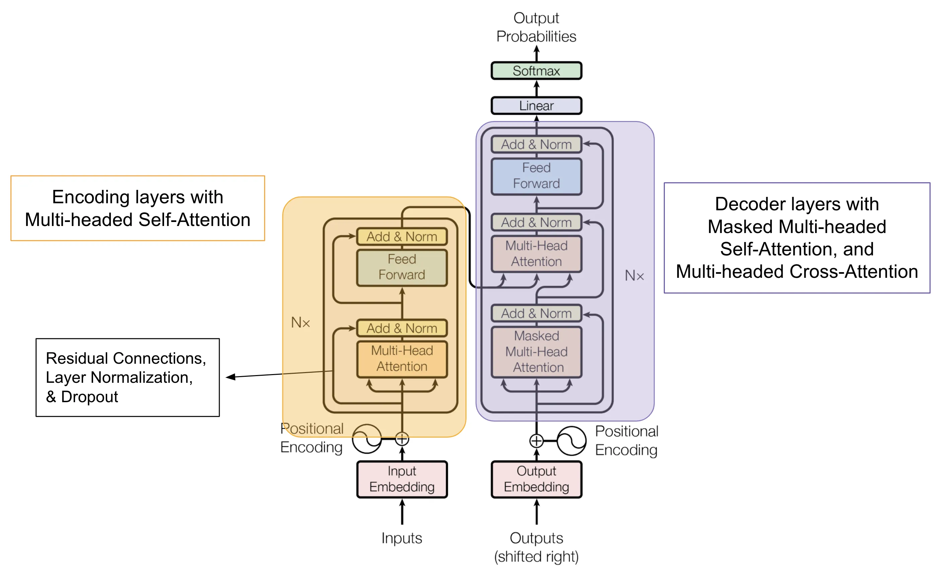
What is a Transformer?
Transformers use self-attention to understand relationships in sequential data.

Slide 8
Final Pipeline for Continuous SLR
Our final approach ensures high accuracy in SLR by combining SMTC and Transformers.
The above approach ensure accuracy in ranges of 50-60%, which motivates us to look for further improvements.

